Slide 1


PROJECT TITTLE :
Greenhouse Gas Emission Prediction using Machine Learning
Internship ID : INTERNSHIP_1748923002683e727a876ea
Presented by :
G.NOVEH KUMAR

Slide 2

Learning Objectives
To understand the sources and environmental consequences of greenhouse gas (GHG) emissions.
To preprocess real-world environmental datasets and handle challenges like missing values, outliers, and skewed data.
To explore regression algorithms (Linear Regression, Decision Tree, Random Forest) for prediction tasks.
To evaluate and compare model performance using statistical error metrics.
To identify and visualize the most influential features contributing to GHG emissions.
To apply tuning techniques (like GridSearchCV) to optimize model accuracy.
To interpret results for actionable insights and potential real-world impact.
GOAL

Slide 3
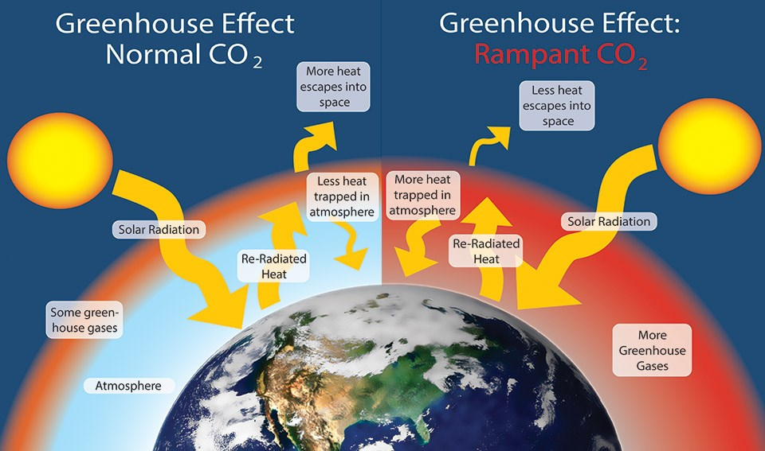
Tools and Technology used
Python 3.10 – Primary programming language for the project.
Jupyter Notebook / Google Colab – For interactive coding and visual analysis.
Key Python Libraries:
pandas – Data manipulation and preprocessing.
numpy – Numerical operations and array handling.
matplotlib & seaborn – Data visualization.
scikit-learn – Machine learning model building and evaluation.
joblib – Saving the trained model as a .pkl file.
Machine Learning Models Used:
Linear Regression (baseline)
Decision Tree Regressor
Random Forest Regressor (final optimized model)
Model Evaluation Metrics:
RMSE (Root Mean Squared Error)
MAE (Mean Absolute Error)
R² Score (Coefficient of Determination)
Hyperparameter Tuning:
GridSearchCV (used to fine-tune the Random Forest model)
Optional Tools:
GitHub – For version control and collaboration.
Streamlit / Flask – For deploying the model as a simple web app (optional).

Slide 4

Methodology
Data Collection
Gathered data from trusted sources like Kaggle/UCI/open government portals.
Included variables like energy consumption, industrial output, and fuel usage.
Exploratory Data Analysis (EDA)
Visualized distributions, trends, and correlations.
Detected outliers, skewness, and data inconsistencies.
Used heatmaps and pair plots to understand feature relationships.
Data Preprocessing
Handled missing values using imputation.
Removed duplicates and outliers to clean the dataset.
Normalized/scaled numerical features for consistent model performance.
Encoded categorical variables if present
Feature Selection & Engineering
Selected relevant input variables with high correlation to emissions.
Created derived features (e.g., emissions per capita, energy intensity).

Slide 5
Methodology
Model Building
Trained multiple regression models:
Linear Regression (baseline)
Decision Tree Regressor
Random Forest Regressor
Split data into training and testing sets (typically 80/20 or 70/30).
Model Evaluation
Compared models using RMSE, MAE, and R² Score.
Plotted predicted vs actual graphs and residual errors.
Hyperparameter Tuning
Applied GridSearchCV to optimize parameters of Random Forest.
Improved accuracy and generalization performance.
Model Saving
Saved the final model in .pkl format using joblib for future use or deployment.

Slide 6
Problem Statement:
Greenhouse gas (GHG) emissions—primarily carbon dioxide (CO₂), methane (CH₄), and nitrous oxide (N₂O)—are major contributors to climate change, global warming, and environmental degradation. These emissions stem from various human activities, including:
Fossil fuel combustion (e.g., in transport, electricity, and manufacturing)
Deforestation and land-use changes
Agricultural practices
Industrial processes
Despite global efforts to reduce emissions, many regions lack real-time tools to accurately estimate or forecast their environmental footprint. Traditional methods for monitoring GHG emissions are often:
Manual and delayed, leading to reactive rather than proactive policy decisions
Expensive and resource-intensive, requiring constant measurements
Not scalable for large geographic areas or long time spans

Slide 7
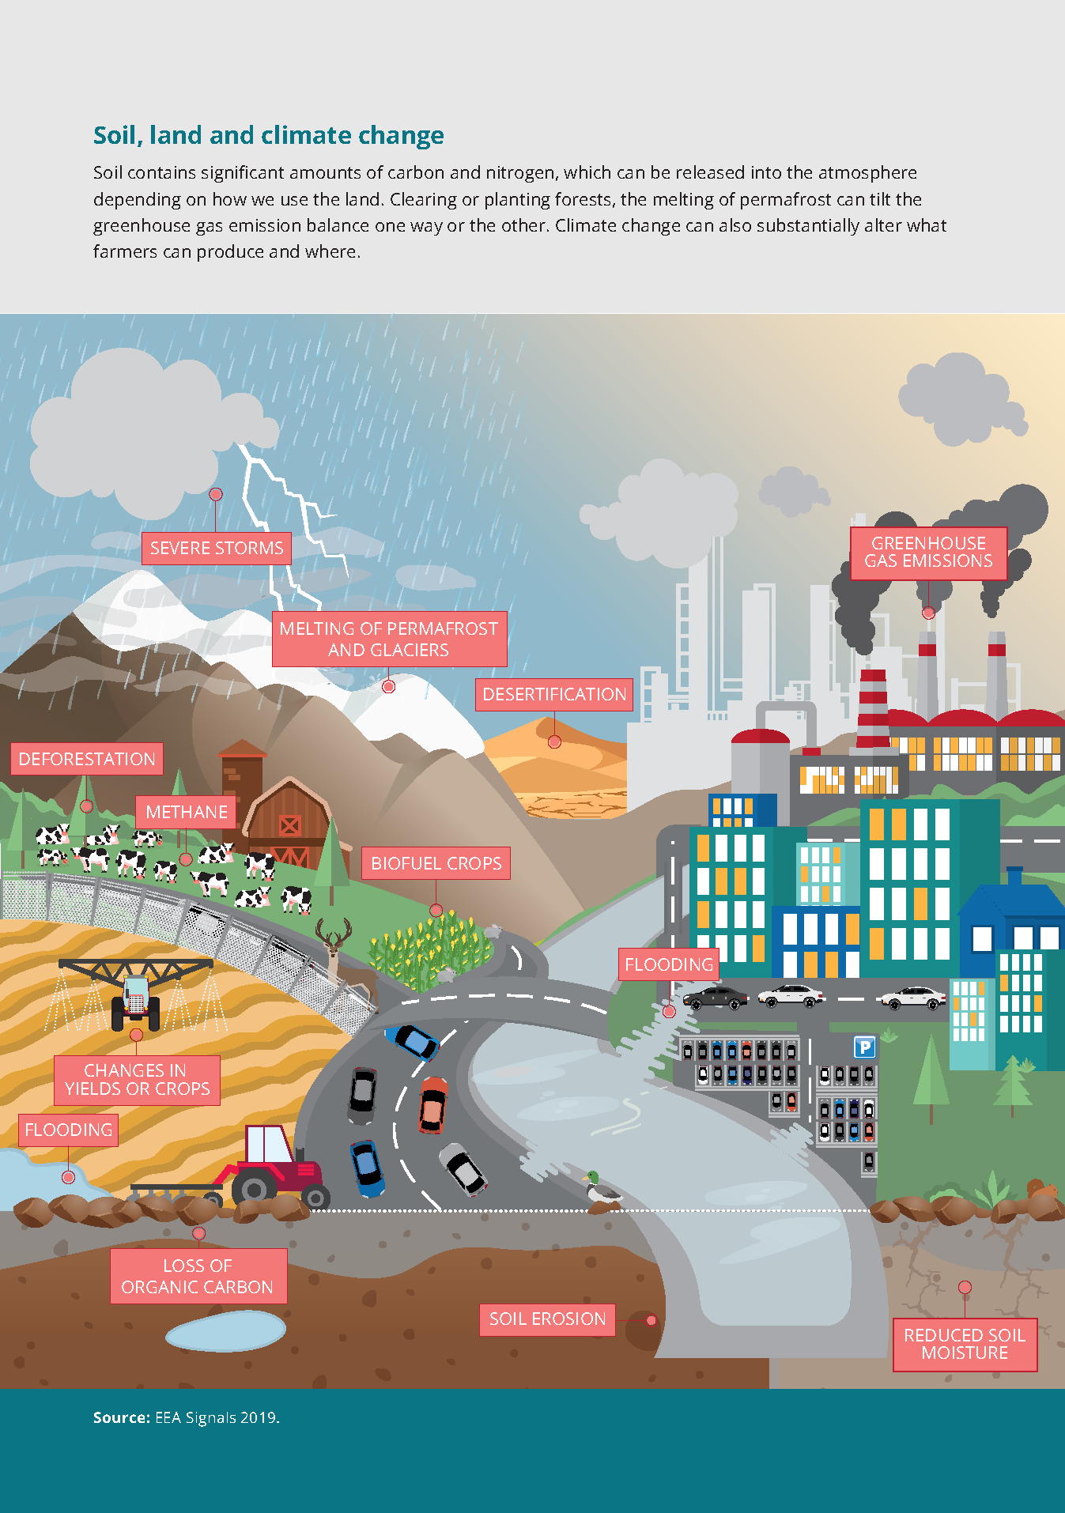
Solution:
We propose a data-driven machine learning approach that:
Ingests diverse environmental data (fossil fuel use, industrial activity, energy generation, etc.)
Cleans and transforms the data for modeling
Uses supervised regression models to learn from historical patterns
Outputs predicted GHG levels with visual confidence
Helps stakeholders focus on the most influential variables, leading to better policy formulation and emissions control
The Random Forest model, due to its ensemble nature, offered robust predictions and highlighted feature importance effectively.

Slide 8
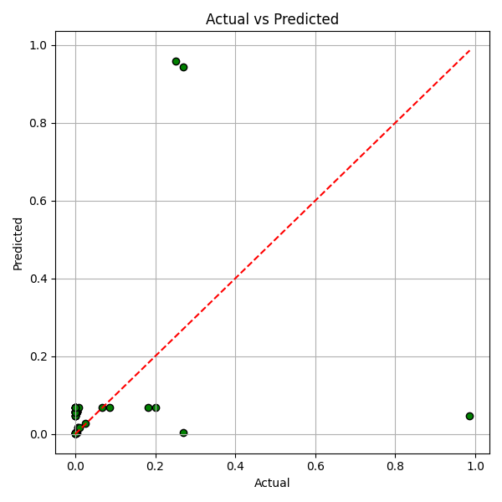
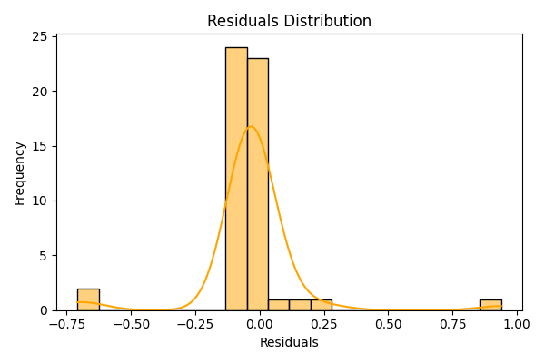
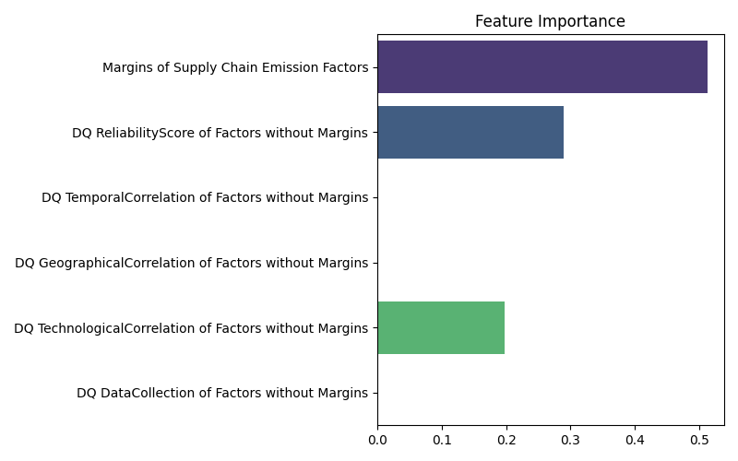
Screenshot of Output:

Slide 9
Conclusion:
Among all the models tested, Random Forest Regressor delivered the best results with a high R² score and low RMSE.
The model successfully identified key drivers of emissions such as industrial fuel consumption and electricity usage.
The approach demonstrates the effectiveness of machine learning in solving environmental prediction problems.
Future work can integrate real-time data streams, use time-series forecasting, or explore deep learning techniques.
This project proves that machine learning can be a valuable ally in climate action and sustainability planning.

